Slide 1
Information Retrieval
Topic- Evaluation in information
Retrieval (unranked evaluation)
Lecture-27
Prepared By
Dr. Rasmita Rautray & Dr. Rasmita Dash
Associate Professor
Dept. of CSE

Slide 2
Evaluation in information
Retrieval

Slide 3
Content
Introduction to evaluation: Measures of an IR system
Evaluation of unranked and ranked retrieval
Evaluation benchmarks
Result summaries

Slide 4
Measures for a search engine
How fast does it index
e.g., number of bytes per hour
How fast does it search
e.g., latency as a function of queries per second
What is the cost per query?
in dollars

Slide 5
Measures for a search engine
All of the preceding criteria are measurable: we can quantify
speed / size / money
However, the key measure for a search engine is user
happiness.
What is user happiness?
How can we quantify user happiness?

Slide 6
Who is the user?
Who is the user we are trying to make happy?
Web search engine: searcher. Success: Searcher finds what she was looking for. Measure: rate of return to this search engine
Web search engine: advertiser. Success: Searcher clicks on ad. Measure: click through rate
Ecommerce: buyer. Success: Buyer buys something.
Measures: time to purchase, fraction of “conversions” of searchers to buyers
Ecommerce: seller. Success: Seller sells something.
Measure: profit per item sold
Enterprise: CEO. Success: Employees are more productive
(because of effective search). Measure: profit of the company

Slide 7
Most Common definition of user happiness: Relevance
User happiness is equated with the relevance of search results to the query.
But how do you measure relevance?
Standard methodology in information retrieval consists of three elements.
A benchmark document collection
A benchmark suite of queries
An assessment of the relevance of each query-document pair

Slide 8
Relevance: query vs. information need
Relevance to what?
First take: relevance to the query
“Relevance to the query” is very problematic.
Information need i : “I am looking for information on whether drinking red wine is more effective at reducing your risk of heart attacks than white wine.”
This is an information need, not a query.
Query q: [red wine white wine heart attack]
Consider document d′: At the heart of his speech was an attack on the wine industry lobby for downplaying the role of red and white wine in drunk driving.
d′ is an excellent match for query q . . .
d′ is not relevant to the information need i

Slide 9
Relevance: query vs. information need
User happiness can only be measured by relevance to an information need, not by relevance to queries.
Our terminology is sloppy in these slides and in IIR: we talk about query-document relevance judgments even though we mean information-need-document relevance judgments.

Slide 10
Unranked evaluation

Slide 11
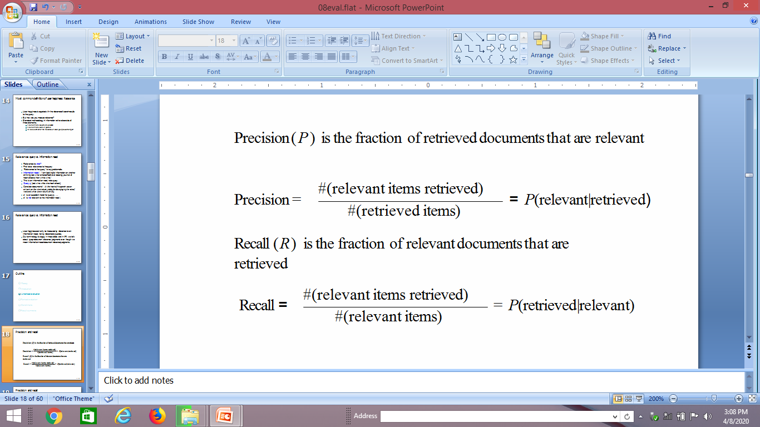
Precision and recall

Slide 12
Precision and recall
 | Relevant | Nonrelevant
Retrieved | true positives (TP) | false positives (FP)
Not retrieved | false negatives (FN) | true negatives (TN)
P = TP/(TP + FP)
R = TP/(TP + FN)

Slide 13
Precision/recall tradeoff
You can increase recall by returning more docs.
Recall is a non-decreasing function of the number of docs retrieved.
A system that returns all docs has 100% recall!
The converse is also true (usually): It’s easy to get high precision for very low recall.
Suppose the document with the largest score is relevant. How can we maximize precision?

Slide 14
Example for precision, recall, F1
 | relevant | not relevant
retrieved | 20 | 40 | 60
not retrieved | 60 | 1,000,000 | 1,000,060
 | 80 | 1,000,040 | 1,000,120
P = 20/(20 + 40) = 1/3
R = 20/(20 + 60) = 1/4
F₁ = 2/7

Slide 15
Thank You

